Slide 1

Circumstances
WSF Culture

Slide 2
Index
1. Start positions
The spiral of creation
Spiral dynamics
Theory U
Extra:
The Celestine Prophecy
The Essene Essence
Dianetics Scn
I Ching, Can Tong Qi
3
8
14
19
25
34
40
46

Slide 3
Evolution
Girl
Sustainable Woman
Woman

Slide 4
Back to basics
Man
Boy
Sustainable Man

Slide 5
Triangle of joy
Assistant
Recipient
Spectator

Slide 6
Drama Triangle
Therapist
Victim
Culprit

Slide 7

Man
Assistant
Therapist
Girl
Sustainable Woman
Victim
Recipient
Boy
Sustainable Man
Spectator
Culprit
Woman

Slide 8
The Spiral of Creation
2.
A natural road
from desire to reality

Slide 9

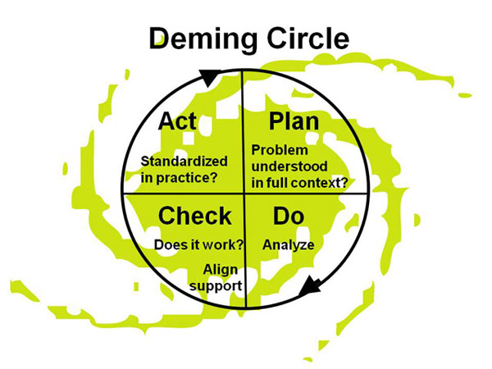
Circle of Deming
Act
Plan
Check
Do

Slide 10
The shortened creation spiral for lack of inspiration
Ignore your
true desires
Pay no
attention to
enjoy
Know and stay
always realistic
Check
Search for
more work
(customers and markets)
Preserve
Act
Plan
Decide
Decide to act
accordingly

Slide 11
The six work areas are all equally indispensable
Wishing
Relax
Depict
Silent
work
Appreciate
Believe
Emotion
work
Positive
think work
Receive
Express
Real work
Network
Preserve
Investigate
Strategy
work
Act
Plan
Decide

Slide 13
Spiral Dynamics
3.
Culture
and Behaviour

Slide 14


Spiral Dynamics Culture
Pro-activity
An open mind
Passion
Positive attitude
Turquoise:
Holistic Meme
Yellow:
Integrative Meme
Green:
Communitarian
Orange:
Activist
Blue:
Authoritarian
Red: Impulsive
Purple: Magical
Beige: Instinctive
https://www.123test.nl/werkwaardentest/

Slide 15

Think Windows
GROSS SUBTLE CAUSAL WITNESS NONDUAL
SUPER
INTEGRAL
PLURAL
RATIONAL
MYTHIC
MAGIC
ARCHAIC
CREATION OF A
NEW ARCHETYPE
HOMO BIOSIMOS
© sbf - emile van essen NEW ARCHETYPE 2

Slide 16
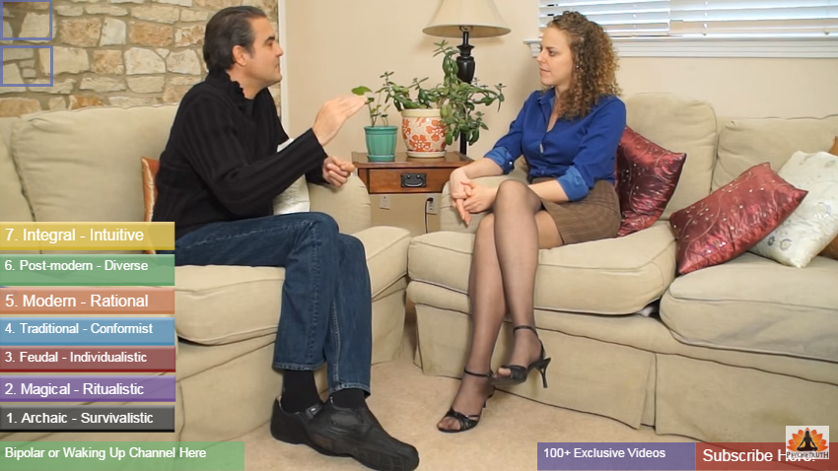
Psychology of Consciousness, Spiral Dynamics, Bipolar or Waking Up

Slide 18
Theory U
4.
The Deepening
Process

Slide 19
U-procedure and Theory U
A change management method to change unproductive patterns of behavior.
Since the early 2000s it has been elaborated as Theory U (also called "U" methodology) by C. Otto Scharmer,
incorporating also his theories of presencing^{[7]} and capitalism 3.0.^{[8]} This work itself draws on collaboration between Scharmer and his colleagues Peter Senge, Joseph Jaworski and Betty Sue Flowers.^{[9]}

Slide 20
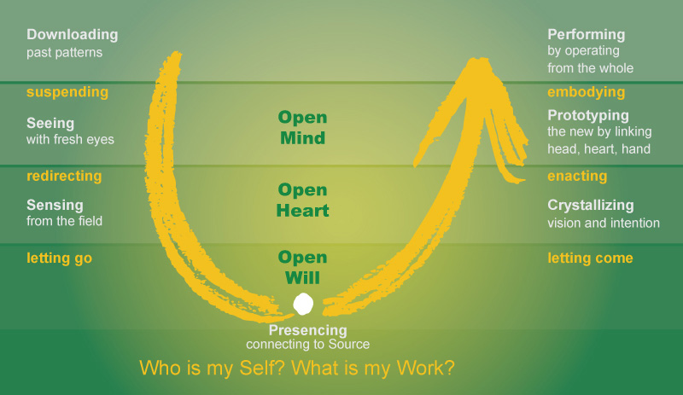
Theory U

Slide 21
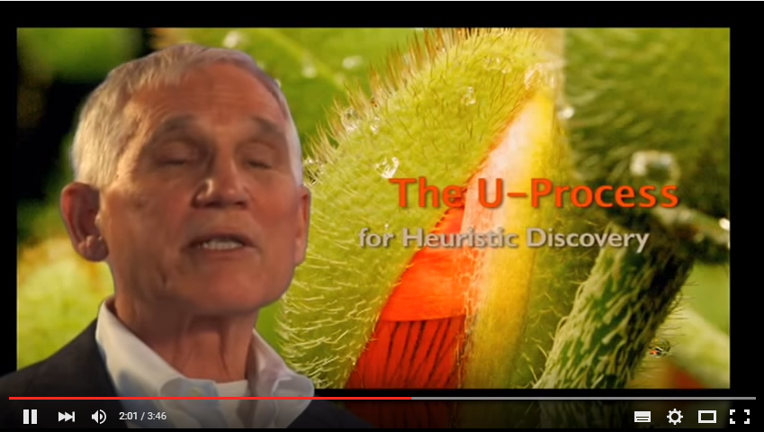
Heuristic discovery

Slide 23
The Celestine Prophecy
5. Extra
Leveled Insights
For connectivity

Slide 24
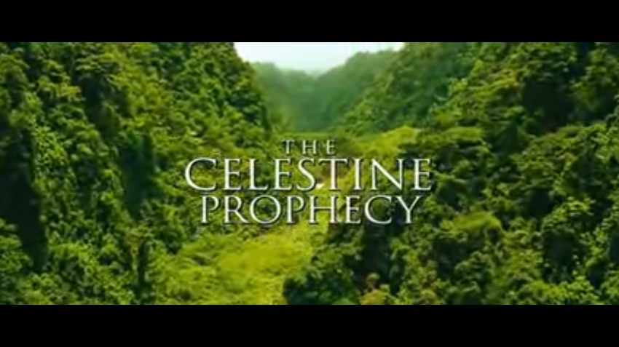
THE CELESTINE PROPHECY
In spite of the conflict and fear, there is a great transformation occurring in the world. People everywhere, across all cultures and religions, are sensing and searching for a more inspired and meaningful life — and finding it!
James Redfield

Slide 25
Insights from THE CELESTINE PROPHECY
* The First Insight... A Critical Mass A new spiritual awakening is occurring in human culture.
* The Second Insight... The Longer Now This awakening represents the creation of a new, more complete worldview, which replaces a five-hundred-year-old preoccupation with secular survival and comfort.

Slide 26

Insights from THE CELESTINE PROPHECY
* The Third Insight... A Matter of Energy We now experience that we live not in a material Universe, but in a Universe of dynamic energy. Everything extant is a field of sacred energy that we can sense and intuit.
* The Fourth Insight... The Struggle For Power To gain energy, we tend to manipulate or force others to give us attention and thus energy.
* The Fifth Insight... The Message of the Mystics Insecurity and violence ends when we experience an inner connection with divine energy within, a connection described by mystics of all traditions.

Slide 27

Insights from THE CELESTINE PROPHECY
* The Sixth Insight... Clearing the Past The more we stay connected, the more we are acutely aware of those times when we lose connection, usually when we are under stress. In these times, we can see our own particular way of stealing energy from others.
* The Seventh Insight... Engaging the Flow Knowing our personal mission further enhances the flow of mysterious coincidences as we are guided toward our destinies.

Slide 28

Insights from THE CELESTINE PROPHECY
The Eighth Insight... The Interpersonal Ethic We can increase the frequency of guiding coincidences by uplifting every person that comes into our lives. Care must be taken not to lose our inner connection when we have become part of romantic relationships.
* The Ninth Insight... The Emerging Culture As we all evolve toward the best completion of our spiritual missions, the technological means of survival will be fully automated as humans focus instead on synchronistic growth.

Slide 29
Insights from THE CELESTINE PROPHECY
* The Tenth Insight. . . Holding the Vision The Tenth Insight is the realization that throughout history human beings have been unconsciously struggling to implement this lived spirituality on Earth.
* The Eleventh Insight. . . Extending Prayer Fields The Eleventh Insight is the precise method through which we hold the vision.
* The Twelfth Insight. . . Sustainable Synchronicity
Move into sync with the spiritual design of the universe. As we act individually, we create together a new cultural approach to life that is the key to solving all the problems facing human society.

Slide 30
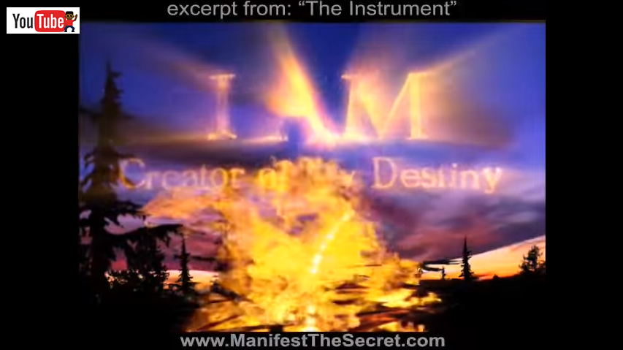
I AM …

Slide 32
The Essene Essence
6. Extra
Natural
Living

Slide 33

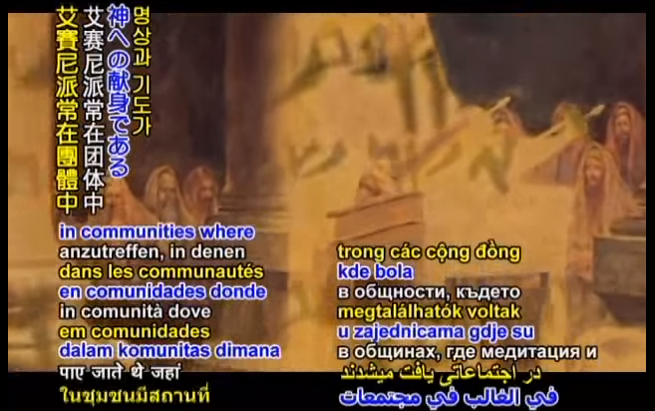
Lessons in Eternal Living

Slide 34
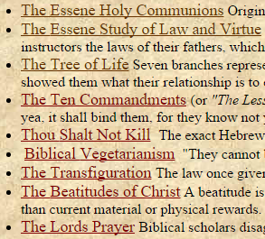
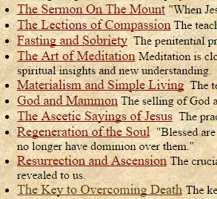
Christians Essene Roots

Slide 35
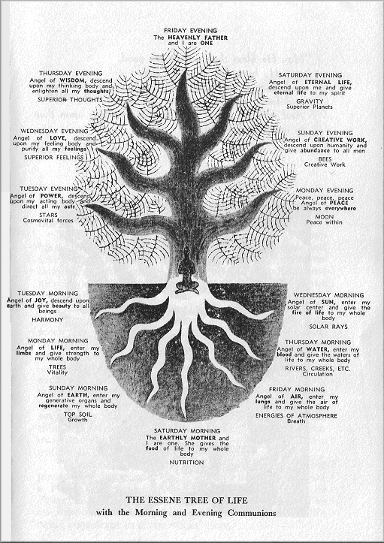
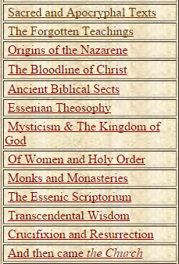

Slide 37
Dianetics Scientology
7. Extra
The Construct

Slide 38
The Mind by Dianetics
Future
1. The Logic
3. The Librarian
2. Awareness Unit
Truth
---- Interpretations
------- Misinterpretations
Time - History

Slide 39
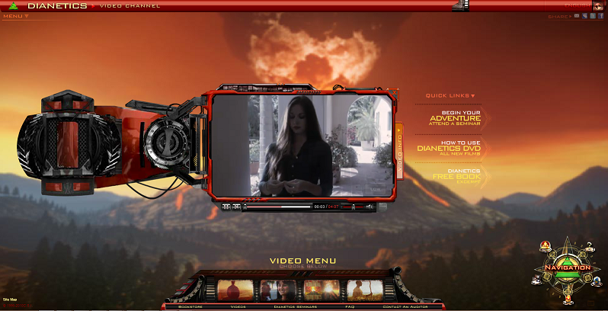
The D Process
Relax
Set aim
Question
Answer
Acknowledge
Unroll time-track
Adjust interpretations
Free circumstances

Slide 40
Scn
Universal findings based on individual process
Dynamics and levels of clear understanding
Span of control
Interest in games
Religion & science
Skills, aims, and society
Understanding life and universe

Slide 42
I Ching Can Tong Qi
8. Extra
The Social
Process

Slide 43

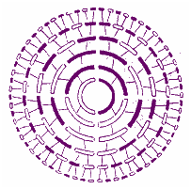
I CHING and CAN TONG QI
From the I Ching we can recognize what is and learn the path of change.
The Can Tong Qi is about the elixir of life and how to become sustainable, both in prosper and in body.

Slide 44
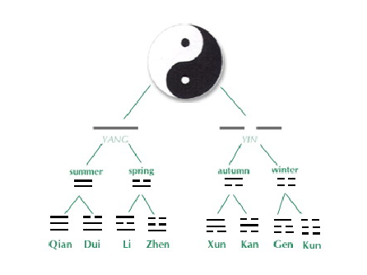

learn the path of change

Slide 45
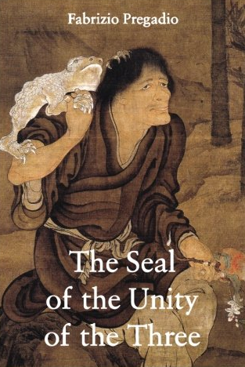

Qian (heaven) is steadfast, Kun (earth) is accommodating.
The Zhou Yi Can Tong Qi is one of the most important texts in the practice of Nei Dan, or Internal Alchemy. It correlates the three major classics of ancient China.

Slide 46
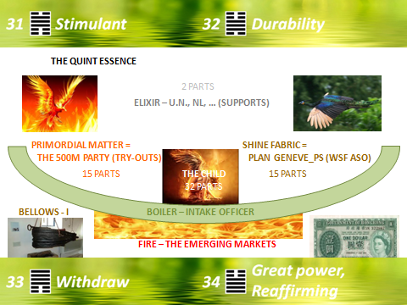

Slide 47
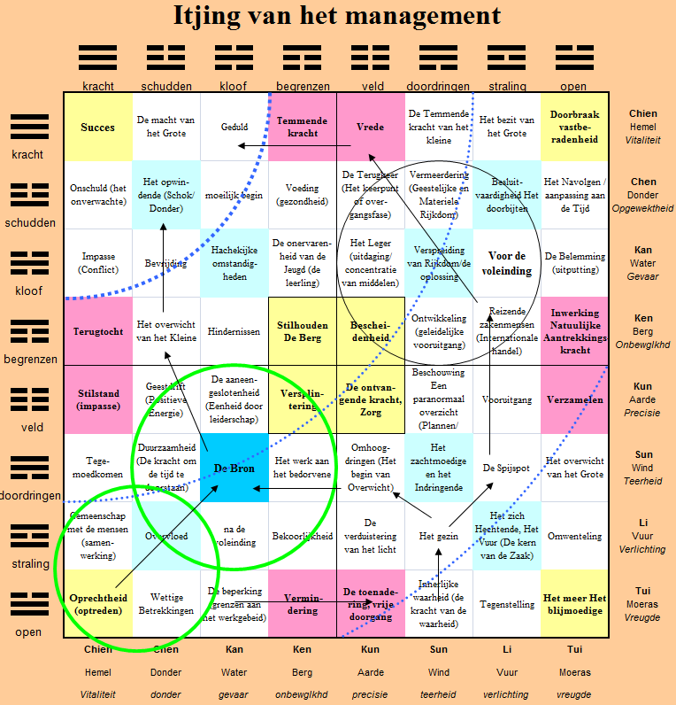


Slide 48


Slide 49
Thank you
WSF Cultural Education

